Slide 1
BALANCING COMFORT AND SAFETY IN POST-OP PAIN MANAGEMENT
Sarah Ball, PharmD Research Assistant Professor
MUSC General Internal Medicine October 26, 2022

Slide 2
DISCLAIMERS: CME Disclosure
Learning Objectives
After this activity, the learners should be better able to: Set appropriate expectations for post-op pain and create a pain management plan with patients prior to surgery date to encourage conservative use of opioids and enhance patient satisfaction; Screen patients to help identify those with or at risk for OUD, depression, and anxiety to help guide pre‐ and post-op strategies, including multi‐modal pain management; Use multi‐modal pain management, including non‐drug strategies, to minimize opioid use and help patients reach treatment goals with fewer medications; Coordinate a post‐op pain management plan with your patient and their primary care provider to continue patient progress and safeguard against persistent opioid use.
Disclosure Statement
In accordance with the ACCME Standards for Integrity and Independence in Accredited Continuing Education anyone involved in planning or presenting this educational activity will be required to disclose any financial relationships with any ineligible companies. An ineligible company is any entity whose primary business is producing, marketing, selling, reselling, or distributing healthcare products used by or on patients. This information is listed below. Any financial relationships with these ineligible companies have been mitigated by the MUSC Office of CME. Speakers who incorporate information about off‐label or investigational use of drugs or devices will be asked to disclose that information at the beginning of their presentation. The following information has been disclosed:
Presenters/Planners/Moderators with NO financial relationships with Ineligible Companies: Kelly Barth, William Basco, Robert Cina, Sandra Counts, Mulugeta Gebregziabher, Nancy Hahn, Lauren Linder, Mark Lockett, Patrick Mauldin, Jenna McCauley, Joseph McElwee, William Moran, Megan Pruitt, Charles Reitman, Sophie Robert, Skip Schumann, David Taber, Ralph Ward, Christopher Wisniewski, Sarah Ball
Presenters/Planners/Moderators with financial relationships with Ineligible Companies: None
Accreditation
The Medical University of South Carolina is accredited by the Accreditation Council for Continuing Medical Education (ACCME) to provide continuing medical education for Physicians.
Credit Designation The Medical University of South Carolina designates this live activity for a maximum of 1.0 AMA PRA Category 1 Credit(s)™. Physicians should claim only the credit commensurate with the extent of their participation in the activity.

Slide 3
DISCLAIMERS
Grant Funding
SCDHHS/Centers for Medicare and Medicaid Services (CME) – Drug Utilization Review Program
This overview is intended to help surgeons and other healthcare professionals in the outpatient management of adult post-op pain. Anesthesiologist-performed multi-modal management procedures and treatment are beyond the scope of this content.

Slide 4
OUR TEAM
tipSC writing team
Sarah Ball, PharmD | Kelly Barth, DO | Sandra Counts, PharmD
Nancy Hahn, PharmD | Lauren Linder, PharmD | Jenna McCauley, PhD
Joseph McElwee, MD | William Moran, MD | Megan Pruitt, PharmD
Sophie Robert, PharmD | Christopher Wisniewski, PharmD
MUSC Drug Information Center assists with background research
Expanded MUSC interprofessional team supporting post-surgical pain management
Prabhaker Baliga, MD | Sarah Ball, PharmD | Kelly Barth, DO | William Basco, MD
Kathleen Brady, MD | Robert Cina, MD | Chloe Bays | Mulugeta Gebregziabher, PhD
Mark Lockett, MD | Justin Marsden | Patrick Mauldin, PhD | Jenna McCauley, PhD
William Moran, MD | Megan Pruitt, PharmD | Charles Reitman, MD | Skip Schumann, MD
Kit Simpson, DrPH | David Taber, PharmD | Ralph Ward, PhD

Slide 5
POST-OP PAIN MANAGEMENT BEGINS BEFORE SURGERY
SET APPROPRIATE EXPECTATIONS
SCREEN PATIENTS
USE MULTI-MODAL PAIN MANAGEMENT
COORDINATE A POST-OP PAIN MANAGEMENT PLAN

Slide 6
TRAJECTORY OF CHRONIC OPIOID USE (COU) POST-SURGERY
(Data analyses to inform educational outreach)
 | Patients
Surgery | Age | Total Count | % COU post-surgery (GLMM) | % COU with concerning trajectory (GBTM) | Total opioid naïve pre-surgery | % opioid naïve with COU post-surgery
Tonsillectomy* | Peds | 11,578 | 3.6%† | 2.9% | 11,468 | 3.2%
Total Knee Replacement | Adult | 1,507 | 69.9% | 36.2% | 530 | 41.9%
Cholecystectomy | Peds | 547 | 16.6% | 1.5% | 377 | 14.1%
Cholecystectomy | Adult | 4,788 | 38.8% | 7.2% | 2184 | 27.1%
Appendectomy | Peds | 1,789 | 7.1%† | 7.1% | 1692 | 6.0%
Lumbar spine | Adult | 1,348 | 76.4% | 45.1% | 259 | 49.4%
Colon resection | Adult | 429 | 54.4% | 34.3% | 173 | 32.9%
All surgeries | ≥ 13 | 10,138 | 37.3% | 16.3% | 4,692 | 18.5%
*Tonsillectomy with or without adenoidectomy
† More than 80% of total had no opioids in pre-exposure period
KEY: GLMM = generalized linear mixed model; GBTM = group-based trajectory model; opioid naïve = no opioids in 90 days prior to surgery
Basco et al. Int J Pediatr Otolaryngol 2021 Cina et al. J Pediatr Surg 2022 Lockett et al. Surgery Open Science 2022 Ward et al. Knee Surg Relat Res 2022 Reitman et al. Spine 2022 McCauley et al. submitted to J Opioid Manag 2022

Slide 7
OPIOID USE PATTERNS IN SOUTH CAROLINA MEDICAID PATIENTS UNDERGOING SELECTED SURGERIES Associations Between Pre-Op and Post-Op Opioid Use
10%
7%
83%
% Post-op Patients
CHRONIC OPIOID USE POST OP
MOSTLY OR FULLY TAPERED OFF OPIOIDS MONTH 9 POST DISCHARGE
ESCALATING OPIOID USE POST OP
South Carolina Medicaid enrollees receiving a selected surgery between 2014 – 2017 (colon resection, lumbar spine, total knee arthroplasty (TKA) ≥ 18 y.o.; cholecystectomy ≥ 13 y.o.; appendectomy and tonsillectomy 13-17 y.o. McCauley et al. submitted to J Opioid Manag 2022

Slide 8
OPIOID USE PATTERNS IN SOUTH CAROLINA MEDICAID PATIENTS UNDERGOING SELECTED SURGERIES Associations Between Pre-Op and Post-Op Opioid Use
CHRONIC OPIOID USE
POST-OP – 10%
Similar use pre-op & post-op
Use remained consistent at low, moderate, or high level
Largest percentage of lumbar spine and TKA patients
Middle age
Patients may benefit from transitional pain services
ESCALATING OPIOID USE POST-OP – 7%
66% had escalating opioid use pre-op
22% had no opioids pre-op
3 out of 4 had higher use month 9 post-discharge compared to pre-op use
Larger percentage of lumbar spine and TKA patients
Middle age
MOSTLY OR FULLY TAPERED OFF OPIOIDS MONTH 9 POST DISCHARGE - 83%
54% no opioids pre-op
42% low to moderate opioid use pre-op
3 out of 4 had ≥ 1 opioid days during 30 days post-discharge
4 out of 5 returned to no opioid use within 2 -3 months post-discharge

Slide 9
SCREEN PATIENTS to help identify those with or at risk for opioid use disorder (OUD), depression, and anxiety to help guide pre- and post-op strategies, including multi-modal pain management.
SCRIPTS provides a quick check for patterns of chronic or escalating opioid use patterns and use of benzodiazepines pre- AND post-op
Be alert to mental health concerns and coordinate care with primary care providers and specialists as needed
Address fears and catastrophizing with caring conversation nuggets

Slide 10
SELECTED PRE-OP SCREENING TOOLS
Tool | Number of Questions | Time to Completion
Substance Use Screenings
SC Prescription Drug Monitoring Program (SCRIPTS) | N/A | 1 – 5 minutes
Opioid Risk Tool (ORT) | 10 | ≤ 1 minute
Single-Item Screens (polysubstance) | 1 (alcohol) 1 (drug) | < 1 minute
Psychological Screenings
PHQ-2 | 2 | < 1 minute
GAD-2 | 2 | < 1 minute

Slide 11
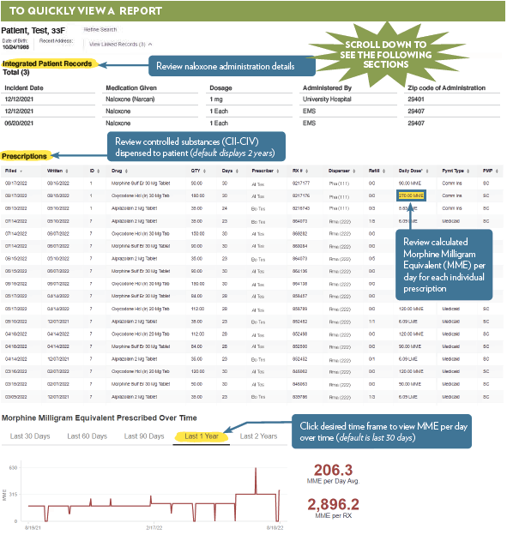
SCRIPTS (PDMP REPORTS) QUICK TIPS AND TRICKS http://southcarolina.pmpaware.net
Review naloxone administration details
Review details of individual controlled substance prescriptions
View opioid use (MME/day) over time
MME/day: Morphine Milligram equivalent per day

Slide 12
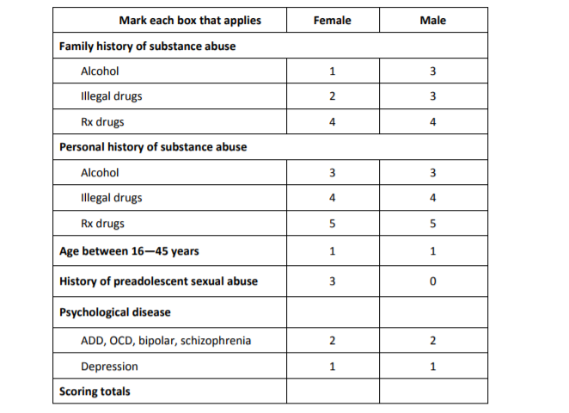
OPIOID RISK TOOL® (ORT)
Description | Number of Questions | Time to Completion
Brief patient self-assessment validated in primary care to help predict the relative risk of opioid misuse and abuse | 10 | ≤ 1 minute
Scoring:
≤ 3: Low Risk
4 – 7: Moderate Risk
≥ 8: High Risk
Webster and Webster. Pain Med 2005

Slide 13
SINGLE-ITEM SCREEN
Tool | Number of Questions | Time to Completion
Single-Item Screen | 1 (alcohol) 1 (drug) | < 1 minute
Scoring:
> 0: Positive
How many times in the past year have you had 5 (male) / 4 (female) or more drinks in a day?
How many times in the past year have you used an illegal drug or prescription medication for non-medical reasons (for example, because of the experience or feeling it caused)?
> 0: Positive
Smith et al. Drug Alcohol Depend 2014

Slide 14
PATIENT HEALTH QUESTIONNAIRE-2
Description | Number of Questions | Time to Completion
Initial depression screen validated for use in primary care (first 2 questions of PHQ-9) | 2 | < 1 minute
Scoring:
≥ 3: Warrants further depression evaluation with PHQ-9
Korenke et al. Med Care 2003

Slide 15
GENERALIZED ANXIETY DISORDER 2-ITEM (GAD-2)
Description | Number of Questions | Time to Completion
Initial generalized anxiety disorder screen (first 2 questions of GAD-7) | 2 | < 1 minute
Generalized Anxiety Disorder 2-Item GAD-2
Over the last 2 weeks, how often have you been bothered by the following problems? | Not at all | Several days | More than half the days | Nearly every day
1. Feeling nervous, anxious, or on edge | 0 | 1 | 2 | 3
2. Not being able to stop or control worrying | 0 | 1 | 2 | 3
GAD-2 score obtained by adding score for each question (total points)
Scoring:
≥ 3: Warrants further anxiety evaluation with GAD-7
Korenke et al. Ann Intern Med 2007 Sapra et al. Cureus 2020

Slide 16
SET APPROPRIATE EXPECTATIONS for post-op pain and create a pain management plan with patients prior to surgery date to encourage conservative use of opioids and enhance patient satisfaction.
Should I expect pain after surgery?

Slide 17
USE MULTI-MODAL PAIN MANAGEMENT, including non-drug strategies, to minimize opioid use and help patients reach treatment goals with fewer medications.
Optimize non-drug options, non-opioid meds, appropriate anesthesiology techniques, and opioids
Associated with better pain control and fewer adverse effects
Encourage patient to adhere to non-drug treatment options regardless of medications prescribed

Slide 18
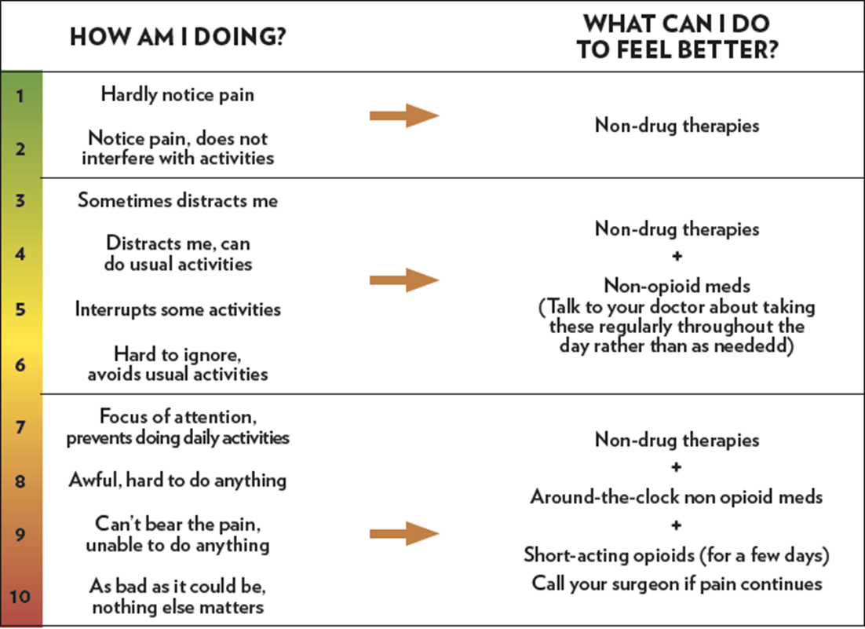
MULTI-MODAL PAIN MANAGEMENT
The goal is function, not zero pain
Safe Pain Control: Common Questions

Slide 19
NON-DRUG STRATEGIES FOR MANAGING SURGICAL PAIN
Just popping a pill is not enough

Slide 20
NON-DRUG STRATEGIES FOR MANAGING SURGICAL PAIN Often used in combination and many are self-care
A good night’s SLEEP is a key part of a patient’s pain management plan:
Pain can reduce sleep quality
Poor sleep may increase pain sensitivity
Raymond et al. Pain 2001 Gerhart et al. Ann Behav Med 2017

Slide 21
MULTI-MODAL MEDICATION MANAGEMENT
Pain Meds

Slide 22
NON-OPIOID MEDS IN MULTI-MODAL (MM) SURGICAL PAIN MANAGEMENT
NSAIDs and APAP together offer better pain control than either alone
Taking both at the same time may improve adherence
For example: 1000mg APAP + 600 mg ibuprofen every 8 hours
Risks of NSAIDS may exceed benefits for some patients
Gabapentin and Pregabalin
Effectiveness data in post-op MM pain control limited and inconclusive
Use not without risk
Includes sedation, respiratory depression, delirium in the elderly
KEY: NSAID(s) Non-steroidal anti-inflammatory drug(s) APAP Acetaminophen
Lunn et al. Pain 2015 Ong et al. Anest Analg 2010 Park et al. JAMA 2022 UpToDate: Nonopioid pharmacotherapy for acute pain in adults

Slide 23
NSAIDS and APAP Risk factors for drug-related adverse effects
Medication Class Medication (Rx max daily dose) | Rx or OTC | Patient Risk Factors Warranting Caution |  |  |  |  | Comments
 |  | Older Adults | CV Risk Factors | GI Risk Factors | Hepatic Dysfunction | Renal Dysfunction
Non-Selective NSAIDS Ibuprofen (3200 mg) Naproxen Sodium (1100 mg)¹ | Rx/OTC |  |  |  |  |  | Risks of CV and GI adverse effects increase with higher doses and longer duration; May be opioid sparing; Consider what has worked in the past
COX-2 Selective NSAIDS Celecoxib (400 mg) | Rx
Analgesic Acetaminophen (4000 mg)² | Rx/OTC |  |  |  |  |  | May have NSAID dose-sparing effect; Minimal drug interactions
1. Naproxen Sodium 1100 mg equivalent to 1000 mg naproxen. 2. Consider 3000 mg maximum, especially if elevated liver function tests, known liver impairment, or older adult. Use 2000 mg maximum in patients with alcohol use disorder or taking warfarin.
Altman RD. Clin Exp Rheumatol 2004 DiPiro et al. Pharmacotherapy Chapter 60 c2017 Hayward et al. Br J Clin Pharmaocl 2016 Lopes et al. Blood 2011 Martinez et al. Clin Ther 2019 Product labeling

Slide 24
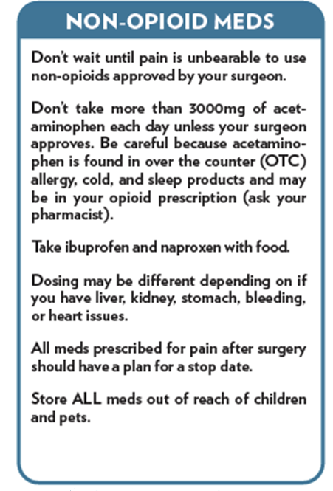
NON-OPIOID MEDS FOR MANAGING POST-OP PAIN Scheduled around-the-clock non-opioids keep patient ahead of pain
No medication is without risks
All meds prescribed for pain after surgery should have a plan for a stop date

Slide 25
OPIOIDS IN MULTI-MODAL (MM) SURGICAL PAIN MANAGEMENT
Prescribe the lowest effective dose of a short-acting opioid for the shortest necessary duration
Provide patient education about risks of opioid therapy prior to prescribing
CDC: Prescription Opioids: What you Need to Know
Opioid Prescribing Network (OPEN): https://michigan-open.org/patients/
SC Code of Laws 44-53-360 limits initial opioid prescription to ≤ 7 days,
with exception for major surgery.

Slide 26
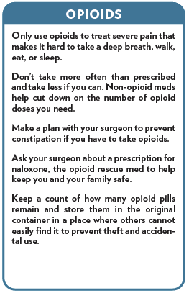
OPIOIDS FOR MANAGING POST-OP PAIN
Important patient reminder: severe pain, not pain itself, is the indication to use an opioid
Tramadol may be less effective than other opioids and NOT necessarily the safer opioid
Shah et al. MMWR Morb Mortal Wky Rep 2017
Turturro et al. Ann Emerg Med 1998

Slide 27
SHORT-ACTING OPIOIDS IN POST-OP PAIN MANAGEMENT
Surgery Category | Discharge Opioid Prescribing¹
 | Number of Tablets | Days Supply
Type 1 – Expected rapid recovery² Patient resumes most activities 2 weeks after surgery | 0 – 12 | ≤ 3
Type II – Expected medium-term recovery Patient resumes most activities 4 weeks after surgery | 0 – 42 | ≤ 7
Type III – Expected longer-term recovery Patient resumes most activities 4 + weeks after surgery | 0 – 60 | ≤ 14
QUICKtip
Calculate tablet count needed for patient’s opioid discharge prescription based on use the last 24 hours before discharge; no discharge opioid prescription is needed if no opioids were required.
^{SC}
Clarke et al. Can J Pain 2020
1. Discharge opioid prescribing guidances: Washington State Agency Medical Director’s Group 2018, Orthopaedic Trauma Pain Task Force 2019 (Hsu et al. J Orthop Trauma 2019), Michigan OPEN Opioid Prescribing Recommendations 2020, Canadian Consensus Statement (Clarke et al. Can J Pain 2020). 2. Excludes 28-tablet recommendation from Orthopaedics.

Slide 28
COORDINATE A POST-OP PAIN MANAGEMENT PLAN with your patient and their primary care provider (PCP) to continue patient progress and safeguard against persistent opioid use. Pre-op and follow-up care coordination
Especially important for patients on chronic or escalating opioid use and patients on medications for Opioid Use Disorder (MOUD)
Share your post-op pain expectations with patient and PCP
Instruct patients on tapering of opioids prescribed for post-op pain

Slide 29
ACUTE OPIOID TAPERS
Stopping pain meds

Slide 30
TAPERING OF SHORT-ACTING OPIOIDS PRESCRIBED FOR POST-OP PAIN
Acute Opioid Tapers Days include Days of Taper
< 7 days → consider 50% reduction every 2 days 7-14 days → ≈ 20-25% reduction every 2 days > 14 days → ≈ 10-20% reduction every 2 – 4 days Percent reduction based on original dose (e.g., if initial reduction is 1 tablet, decrease by 1 tablet each time)
Reduce dose, then extend the dosing interval
The last dose of taper should be the nighttime dose
Acute tapering guidances: American Pain Society Guidelines on Post-Op Pain Management 2016, CDC Clinical Practice Guideline for Prescribing Opioids 2022 (draft), HSS Patient Guide by Dave 2018.

Slide 31
MEDICATION DISPOSAL – BETTER SAFE THAN SORRY
Safe disposal is for ALL meds and supplements, not just opioids and other controlled substances
TAKE BACK OR MAIL BACK
Preferred method of disposal
DISPOSAL IN HOUSEHOLD TRASH
When take back unavailable
FLUSHING DOWN TOILET
FDA Flushable List (primarily opioids)

Slide 32
SPECIAL CONSIDERATIONS FOR PATIENTS ON CHRONIC OPIOIDS FOR PAIN
May require higher doses of short-acting opioids than an opioid naïve patient to treat acute post-op pain
New onset acute pain often undertreated
Need a tapering plan for opioids prescribed for post-op pain just like EVERY patient receiving acute post-op opioids
Share pain expectations after recovery with patient, referring MD, and primary care provider
Coluzzi et al. Ther Clin Risk Manag 2017 Hsu et al. J Orthop Trauma 2019

Slide 33
SHOULD I TAPER CHRONIC OPIOIDS PRE-OP?
No definitive evidence to encourage or discourage
Some studies suggest benefit
Is it due to the taper or characteristics of the patient?
Fully engage patients early on
Any pre-op taper should be GRADUAL
“Reluctant tapering” may increase risk of overdose
Co-prescribe naloxone if patient has none on hand
Tolerance to previous dose lost within 1 – 2 weeks on reduced dose or abstinence
Bickman et al. Amer J Health Syst Pharm 2019 Jain et al. Spine 2021 Nguyen et al. J Arthroplasty 2016 UpToDate: Management of acute pain in the patient chronically using opioids for non-cancer pain UpToDate: Opioid tapering for patients with chronic pain Wang et al. Neurosurgery 2021

Slide 34
“SLOWER” TAPERS FROM SELECTED GUIDELINES FOR PATIENTS ON CHRONIC OPIOID THERAPY
Percent reductions below are based on the original dose before starting the taper, NOT the previous dose (e.g., if the initial decrease is 15 mg, you decrease by 15 mg every time if using the same percent reduction)
Guideline | Slower Taper Recommendations (until discontinue or at dose reduction goal)
VA/DoD Clinical Practice Guideline for the Use of Opioids in the Management of Chronic Pain 2022 | 5 - 20% reduction every 4 weeks Pauses in taper as needed
Canadian Guideline for Use of Opioids for Chronic Non-Cancer Pain 2017 | 5 - 10% every 2 to 4 weeks Frequent follow-up
CDC Guideline for Prescribing Opioids for Chronic Pain 2016¹ | 10% reduction every month, especially if long term use Pauses in taper as needed
1. Aligns with CDC Clinical Practice Guideline for Prescribing Opioids 2022 (draft).

Slide 35
SPECIAL CONSIDERATIONS FOR PATIENTS ON MEDICATIONS FOR OPIOID USE DISORDER (MOUD)
Just like any other patient, patients with opioid use disorder (OUD) need treatment for surgical pain
Offer support, not stigma
Coordinate care pre-op and post-op

Slide 36
SPECIAL CONSIDERATIONS FOR PATIENTS ON OPIOID AGONISTS FOR OPIOID USE DISORDER
More recent guidance and expert opinion recommend continuation of both methadone (full opioid agonist) and buprenorphine (partial opioid agonist) throughout the perioperative period
Change from past practice to discontinue buprenorphine to free up mu-opioid receptors for full opioid agonist
Adequate analgesia
Less chance for relapse and harm
May require higher doses of additional opioids than an opioid naïve patient to achieve same analgesic effects
Can use higher potency full agonists
Coordinate care pre-op and post-op
Acampora et al. J Clin Psychiatry 2020 Buresh et al. J Gen Intern Med 2020 Lembke et al. Pain Med 2019 Warner et al. Mayo Clinic Proc 2020

Slide 37
SPECIAL CONSIDERATIONS FOR PATIENTS ON THE OPIOID ANTAGONIST NALTREXONE FOR OPIOID USE DISORDER
Require close monitoring beginning with discontinuation until restarting therapy 7 – 10 days after last opioid dose
Patients on paused therapy for surgery may experience increased sensitivity to opioids
Coordinate care pre-op and post-op
Also used to treat alcohol use disorder (AUD)
Harrison et al. Anesthesiol Clin 2018 Hsu et al. J Orthop Trauma 2019
Sigmon et al. Am J Drug Alcohol Abuse 2012

Slide 38
PERIOPERATIVE MOUD GUIDANCE
Perioperative Buprenorphine (immediate release): Pre-op: confirm outpatient dose, coordinate approach with prescribing provider and anesthesiologist (hospitals can vary in preferred approach), and discuss with patients their drug and non-drug pain management preferences. Dosing considerations gathered from approaches used at multiple institutions include:
Anticipated Mild Pain: Continue home daily dose pre-op, including morning of planned surgery. Utilize routine mild post-op pain care. For additional pain control, consider splitting home dose and give every 8 hours.
Anticipated Moderate to Severe Pain + addition of full opioid agonist: Continue home daily dose pre-op, including morning of planned surgery OR consider: reducing home daily dose to 16 mg (if applicable) day prior to surgery, reducing any dose > 12 mg to 8 – 12 mg day of surgery and early post-op, and dividing dose. Generally, home buprenorphine dose should be reinstituted at discharge.
Acampora et al. J Clin Psychiatry 2020 Buresh et al. J Gen Intern Med 2020 Lembke et al. Pain Med 2019 Warner et al. Mayo Clinic Proc 2020

Slide 39
PERIOPERATIVE MOUD GUIDANCE
Perioperative Methadone: Pre-op, confirm with opioid treatment program (OTP) clinic: outpatient dose, last day of dose administration, and if the patient was dispensed any take home doses. Continue daily dose pre-op including morning of planned surgery. Consider dividing daily dose and administer every 8 hours early post-op. If divide dose, reinstitute single daily dose at least by day of discharge.
Perioperative Naltrexone: Contact prescriber to discuss injection interval. Schedule surgery to coincide with low naltrexone levels (typically 4 weeks after injection). For any patient on oral naltrexone, discontinue tablet 72 hours prior to surgery.
Alford et al. Ann Intern Med 2006 CA Bridge. Acute Pain Management in Surgical Units South Dakota State Medical Assoc Opioid Guidance 2019 Ward et al. Anesth Anal 2018

Slide 40
NALOXONE
Opioid antagonist that effectively reverses respiratory depression in opioid overdose
Has a higher affinity to the opioid receptors than opioids
Knocks other opioids off the receptors for 30 – 90 minutes
Allows person to breathe
Only reverses the effects of opioids
CALL 9-1-1
Co-prescribe naloxone if not on hand for any patient at higher risk of overdose (e.g., ≥ 50 MME/day, benzodiazepine use, patients with OUD)
SC Code of Laws 44-53-361
http://www.scstatehouse.gov

Slide 41
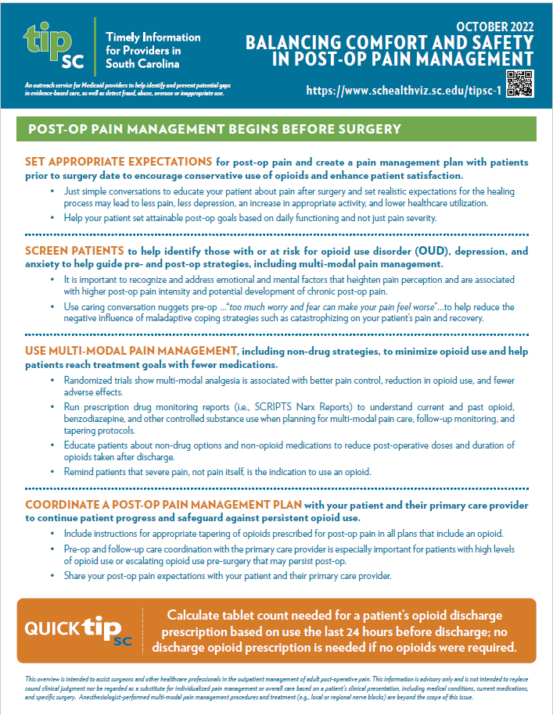
Balancing Comfort and Safety in Post-Op Pain Management (October 2022)
Balancing Comfort and Safety in Post-Op Pain Management
trifold available online in November 2022
Managing Your Pain After Surgery Patient Handout
available online October 2022
Managing Your Pain After Surgery Patient Handout References
available online October 2022
SCRIPTS (PDMP Reports) Quick Tips and Tricks
available online October 2022
Promoting Safe Medication Disposal (March 2019)
Medication Disposal Patient Handout (updated)

Slide 42
Cooper River Bridges
Sarah Ball, PharmD
ballsj@musc.edu
843.876.2904
Megan Pruitt, PharmD
jamisomr@musc.edu
Lauren Linder, PharmD
linderl@musc.edu
Photo Taken By: C. Frank Starmer https://creativecommons.org/licenses/by-nc-sa/3.0/

